Slide 1
Analyzing the relationship between job satisfaction and employee attrition
Capstone Project – MIS581: Business intelligence and data analytics
Joshua Wei
06Oct2024
Notes:
Good [morning/afternoon], everyone. Today, I will be presenting the findings from my Capstone Project on the relationship between job satisfaction and employee attrition. This analysis is based on the IBM HR Employee Attrition dataset, which contains data from 1,470 employees and 35 variables. We'll explore how job satisfaction impacts employee turnover and discuss strategies to improve retention.

Slide 2
Introduction to employee attrition
Definition: What is employee attrition?
Impact of high attrition rates: Financial, productivity, and morale costs
Notes:
Employee attrition refers to the loss of employees due to turnover, which can have significant consequences for organizations, including high costs related to recruitment and training, as well as reduced team stability and productivity. Retaining employees has therefore become a critical focus for organizations.

Slide 3

Study objectives
Primary objective: Analyze the relationship between job satisfaction and attrition
Secondary objective: Identify other key factors contributing to attrition (e.g., work-life balance, compensation
Notes:
The primary goal of this study is to explore the link between job satisfaction and employee attrition rates. I also look into other factors, such as work-life balance and compensation, to provide a more comprehensive view of what drives employees to leave their organizations.

Slide 4
Research design & Hypothesis
Dataset Overview: 1,470 employees, 35 variables
Research Question: Does job satisfaction significantly influence attrition?
Hypotheses:
H0: No significant relationship between job satisfaction and attrition.
A significant relationship exists between job satisfaction and attrition.
Notes:
"This research utilizes the IBM HR Employee Attrition dataset, which includes detailed data on employees' demographics, job roles, and job satisfaction. The main research question is whether job satisfaction affects employee attrition. I hypothesize that lower job satisfaction leads to higher attrition rates."

Slide 5
Methodology
Data Preprocessing: Cleaning, handling missing values, and encoding variables
Statistical Techniques: Logistic regression, chi-square test, and exploratory data analysis (EDA)
Notes:
To analyze the dataset, I applied several preprocessing techniques such as removing missing values, encoding categorical variables, and normalizing continuous data. I then used logistic regression to predict attrition based on job satisfaction and conducted chi-square tests to assess the significance of the relationships.

Slide 6
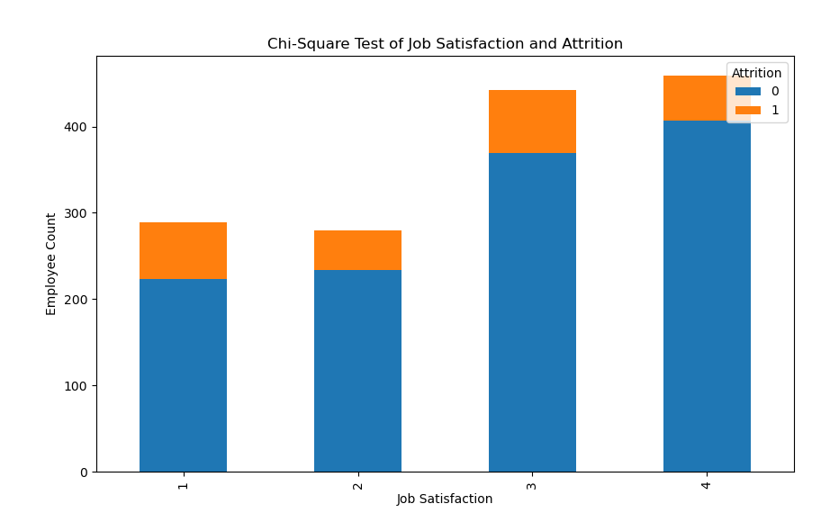
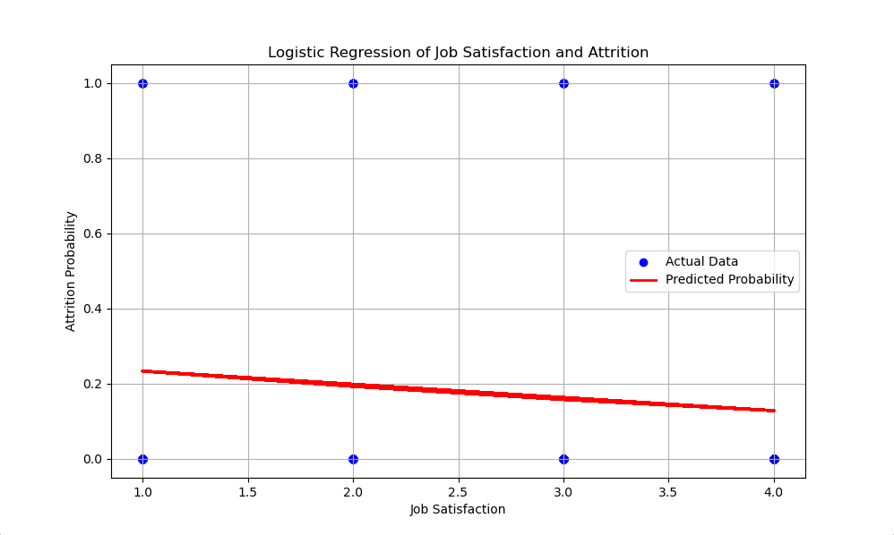
Key findings
Chi-square Test: p=0.002, rejecting the null hypothesis
Logistic Regression Results
Job satisfaction had a statistically significant impact on attrition (p<0.05)
Odds ratio: 0.72 (28% reduction in attrition per unit increase in satisfaction)
Notes:
My analysis revealed that job satisfaction is a significant predictor of employee attrition. For every one-unit increase in job satisfaction, the odds of attrition decreased by approximately 28%. This was further confirmed by the chi-square test, which showed a statistically significant relationship between job satisfaction and attrition.

Slide 7
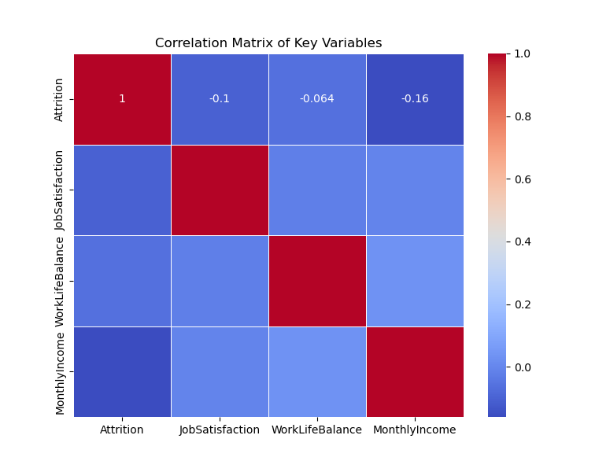
Correlation analysis
Moderate Negative Correlation: Job satisfaction and attrition (-0.1)
Other Factors: Work-life balance and monthly income also showed weaker but relevant correlations
Notes:
The correlation analysis showed a moderate negative correlation between job satisfaction and attrition. Additionally, work-life balance and monthly income were also correlated with turnover, though not as strongly as job satisfaction."

Slide 8

recommendations
Enhance Job Satisfaction Initiatives
Promote Work-Life Balance
Optimize Compensation Packages
Regular Monitoring of Employee Satisfaction
Notes:
Based on the findings, I recommend that organizations focus on improving job satisfaction through recognition programs, career development opportunities, and feedback. Additionally, offering flexible work options and competitive compensation packages can help reduce turnover. Regular monitoring of employee satisfaction is also essential for proactive retention strategies.

Slide 9
conclusion
Main Conclusion: Job satisfaction significantly reduces attrition
Importance of Multi-faceted Retition Strategies
Future Research: Consider longitudinal studies for better insights
Notes:
In conclusion, this study confirms that job satisfaction is a significant factor in reducing employee attrition. However, to effectively retain employees, organizations must take a holistic approach, addressing work-life balance and compensation as well. Future research could explore how these factors evolve over time through longitudinal studies.

Slide 10
Thank you
Joshua Wei
joshua.wei@csuglobal.edu
Notes:
Thank you for your time and attention. I'm happy to take any questions you may have about this research.

Slide 11
references
Allen, D. G., & Bryant, P. C. (2012). Managing employee turnover: Dispelling myths and fostering evidence-based retention strategies. Business Expert Press.
Cascio, W. F., & Boudreau, J. W. (2016). Investing in people: Financial impact of human resource initiatives (3rd ed.). FT Press.
Griffeth, R. W., Hom, P. W., & Gaertner, S. (2000). A meta-analysis of antecedents and correlates of employee turnover: Update, moderator tests, and research implications for the next millennium. Journal of Management, 26(3), 463-488.
Hausknecht, J. P., & Trevor, C. O. (2011). Collective turnover at the group, unit, and organizational levels: Evidence, issues, and implications. Journal of Management, 37(1), 352-388.
Hom, P. W., & Griffeth, R. W. (2021). Employee retention and turnover: Why employees stay or leave. Routledge.
Hom, P. W., Lee, T. W., Shaw, J. D., & Hausknecht, J. P. (2017). One hundred years of employee turnover theory and research. Journal of Applied Psychology, 102(3), 530–545.
Lee, T. W., Hom, P. W., Eberly, M. B., & Li, J. (2018). Managing employee retention and turnover with the unfolding model of voluntary turnover. Human Resource Management Review, 28(1), 34-49.
Meyer, J. P., Stanley, D. J., Herscovitch, L., & Topolnytsky, L. (2002). Affective, continuance, and normative commitment to the organization: A meta-analysis of antecedents, correlates, and consequences. Journal of Vocational Behavior, 61(1), 20-52.

